Slide 1

ARGENTINA ENERGY INVESTMENT OPPORTUNITY
Offshore Round 1
November, 2018
Site of the Round: Click Here

Slide 2
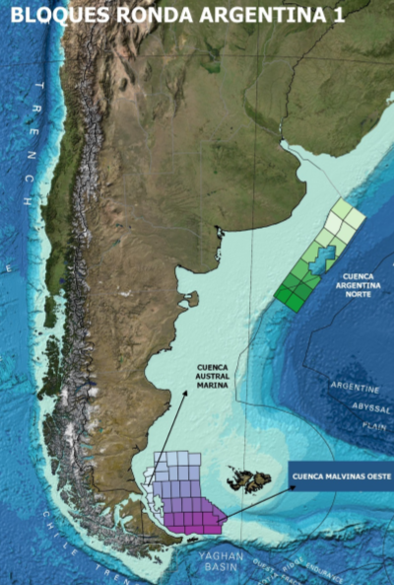
Offshore Project Description
Opportunity Description
Through an International Public Bid (Resolution 65/2018), the Energy Secretariat invites interested companies to award exploration permits in order to search hydrocarbons in offshore areas (located after 12 nautical miles).
The general goal of this Round is to increase awareness of Argentine Offshore opportunities through real investments in Exploration, carried out by companies with the technical and financial capacity to fulfill the objectives of the Round.
38 blocks included in Round 1 (225.000 km2):
  West Malvinas Basin: 18 Deepwater blocks (90.000 km2)
  North Argentina Basin: 14 Deepwater blocks (130.000 km2)
  Austral Basin: 6 Shallow water blocks (5.000 km2)
Royalties linked to success: Starting at 5% to 12% based on:
  R factor = (ƩSales-ƩRoyalties)/(ƩE&A+ƩInvestments+ƩOPEX)
Bidding Timeline
2018
Nov 06th
2019
Feb 14th
Mar 14th
Apr 15th
Jul 30th
Terms of Reference Publication
Deadline for Comments Reception
Receipt & Analysis of Bids
Award Date
Estimated Date for Blocks Transfer Agreement

Slide 3
Main Terms & Conditions
Technical & Economic Requirements
Companies that do not meet the established requirements must present a technical and / or economic guarantee of their controlling companies that meet the stated qualification requirements (depending on the case).
Long Duration Exploration Permit: Three periods (4+4+5 years) for all blocks (except shallow waters: 4+3+4). Obligation to drill one well in 2nd Period and on Extension Period.
The bidder must present a bid maintenance guarantee of 100.000 USD for each of the areas offered.
The sealed envelope must contain the corresponding offer submission form, where the following information will be consigned: A) The working units that the bidder undertakes to carry out during the first exploration period. B) If applicable, the entry bonus.
Bid (usd) = WU x 5000 (usd/WU) + Bonus* (usd)
WU : Working Units offered for 1st Exploration Period. Must be higher than or equal to Minimum Working Units
*Bonus is accepted only if WU > Basic WU; to be paid 50% upfront + 50% end of 3rd year exchangeable for WU done in the first 3 years in addition to Offered WUs

